Slide 1
Drive Marketing Analytics using Power BI
Vijay Ganesan
Senior Business Development Manager - Europe
19/03/2019

Slide 2

Business Context & Objective
Client’s marketing team wanted to build a Centralized Marketing Information System to measure Marketing KPIs from a range of marketing activities across different channels.
Business
Context
LatentView built a centralized visualization & analytic solution framework encompassing the integration of all business metrics into a fully automated and consolidated dashboard. The work scope included :
Gathering Business Requirement & Data Understanding
Development of data pipelines, processing of data & creating centralized dashboard
Enabling transparency of refreshed data, date refreshed & broken pipelines, if any
Full/Partial automation of the end to end work flow
Objectives

Slide 3










Solution Overview
Data Labs “a combination of technology, data and people that will enable growth in next-generation reporting, provide an information edge in traditional business models, and support analytics in other business areas”
Social
Search
Data Layer
Multiple data sources
Websites
Email
Server / Flat files / CRM
Webcasts
DataLabs
Distributed data storage and computing, horizontally scalable to deal with increasing data volumes and analytical needs, and with a range of modern analytical tools available
Cloud Layer / Server Layer
Faster centralized access based on data & technology complexity
Data profiling
Data blending and wrangling
Data exploration
Data visualisation
Model development
Stream analytics
Indexing and search
Range of analytical activities supported
Marketing KPIs
Campaign Tracking
Reporting Layer
Power BI / Others
Lead generation model
Digital dashboards
Reputation Tracking
Retention Model
Audience targeting - Campaigns

Slide 4
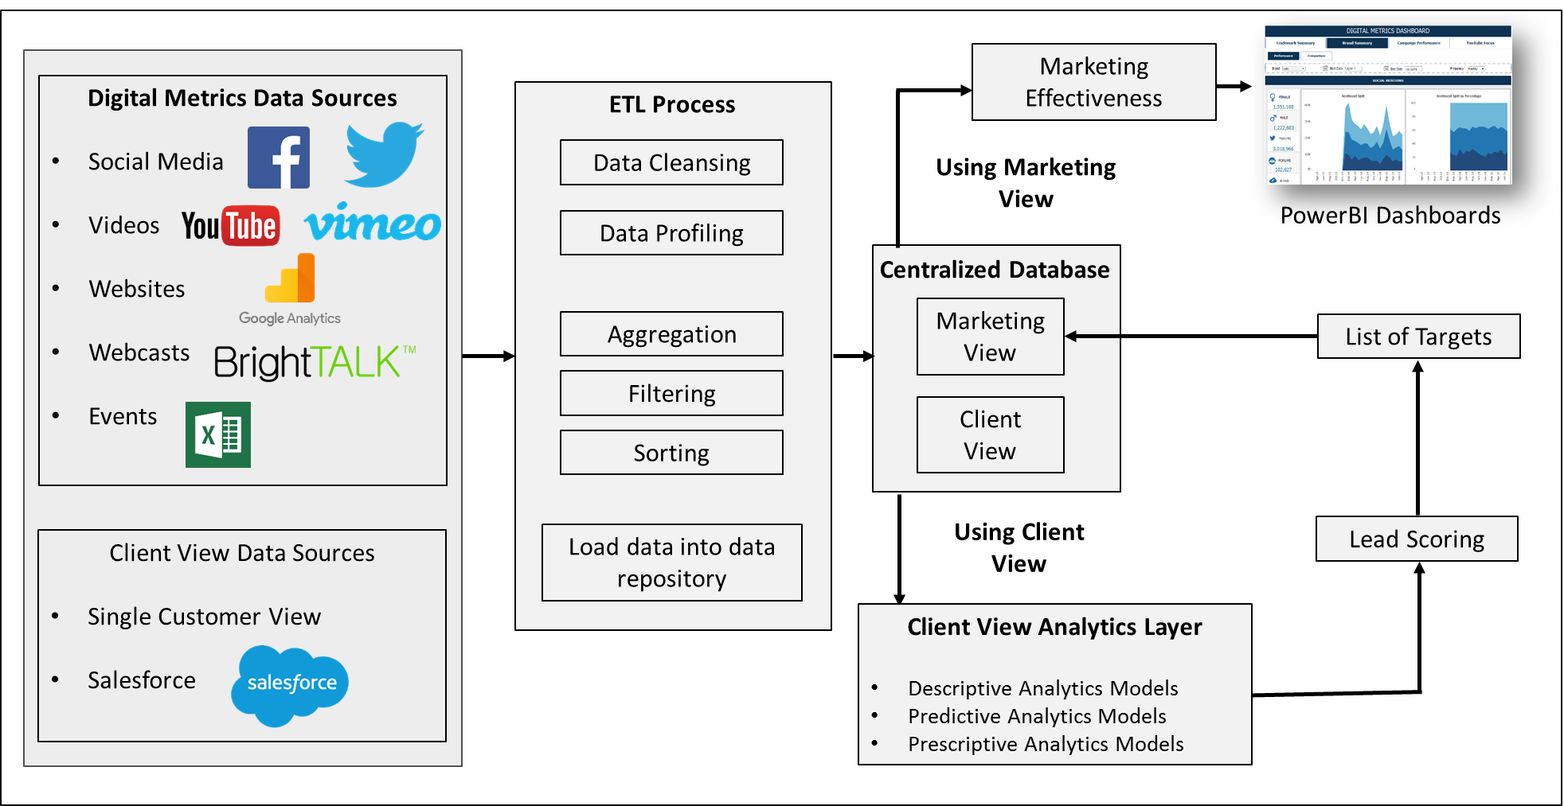
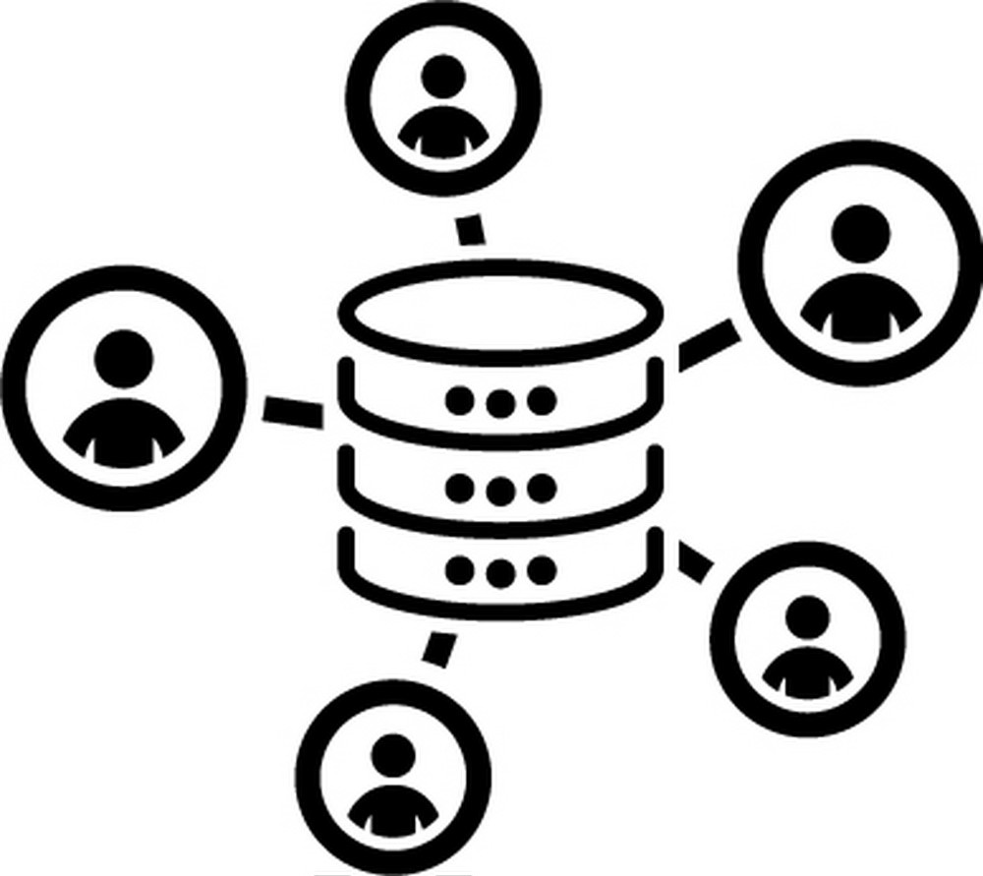



Process & Challenges
Methodology
Key Business Challenges
Data Accessibility
Data Quality
As data was present across multiple sources, getting access to required data was a time consuming activity
Quality of data to build the required dashboards were unclean & required lot manual cleaning & standardization
The input data from multiple sources is first collated and pushed into staging database.
This data is then pre processed , cleaned and standardized
Using custom functions, required data wrangling is carried out to ensure clean and uniform data available for modeling and reporting
No specific user in mind
KPI Definition
Many times, dashboards will be set up without the specific user in mind, making it generally difficult for everyone to operate

Slide 5
Project Plan
WBS | Activities | <- Week ->
 |  | 1 | 2 | 3 | 4 | 5 | 6 | 7 | 8 | 9 | 10 | 11 | 12 | 13 | 14
1 | Discovery Phase (Business Understanding)
1.1 | Understanding the Data & KPI's
1.2 | Finalizing the list of data sources
1.3 | Designing the Wireframe & Reporting Platform
2 | Database Unification - Data Collection
2.1 | Data Collection
2.2 | Data Integration
3 | Building Data Mart (ETL)
3.1 | Data Processing: Consolidation & Cleaning
3.2 | Data Processing: Transformation/Formatting & Storing into Data Mart
4 | Building Dashboards (Power BI)
4.1 | Identifying critical KPI metrics
4.2 | Building the Dashboard representing KPIs using interactive charts
4.3 | Stakeholders Feedback Loop
5 | Final Delivery
5.1 | User Acceptance Testing
5.2 | Feedback Implementation & Dashboard Launch
Project had single PoC/Program Manager from client to brief on data availability and explaining the business requirements & landscape.
ASI team provided the necessary Power BI desktop licenses and database access needed for the completion of the project
LV team worked closely with business stakeholders to identify GAPs in KPI’s & segments in the context of current reports & shared recommendations to achieve the objectives

Slide 6

Data KPI
Campaign Target Identification
Campaign Performance KPI’s
Basis the campaign objective , the campaign target module developed by LatentView identifies audience who are highly likely to buy services or products . The ideal audience group for a campaign is identified using following approaches
Basis the type of campaign channel, some of the KPI’s which are tracked are listed below
Email
Webcast
Events
Business Metrics
Bounce Rate
Delivery Rate
Open Rate
CTR
Unsubscribe Rate
Spam Rate
Avg Rating
Avg Time Spent
Total Views
Unique View
#Users
#Registrations/Visitors
NPS
Social Media Mentions
Unique View
#Returning Attendees
RFM
Similarity Model
Event Tones
Past Engagements
Business Rules
#Leads
CLTV
Cost per Lead
ROI
#Conversion Rate
Campaign Target

Slide 7
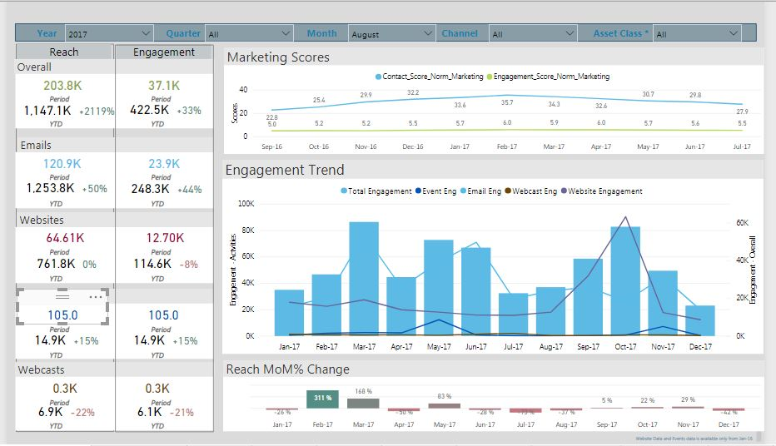
Power BI Screenshots – Marketing KPI Measurement
In the below dashboard screenshot, Websites data from Google Analytics (Millions of records), Emails data from Oracle Eloqua & Salesforce (Millions of records) & Webcasts data from BrighTALK & QUMU (Hundreds of records) are combined to calculate Marketing KPIs (Reach & Engagement)

Slide 8
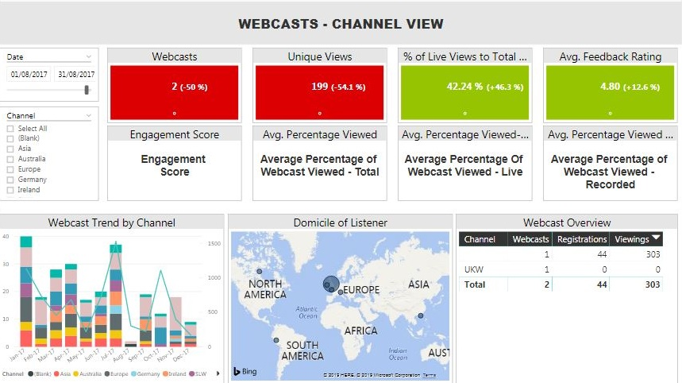
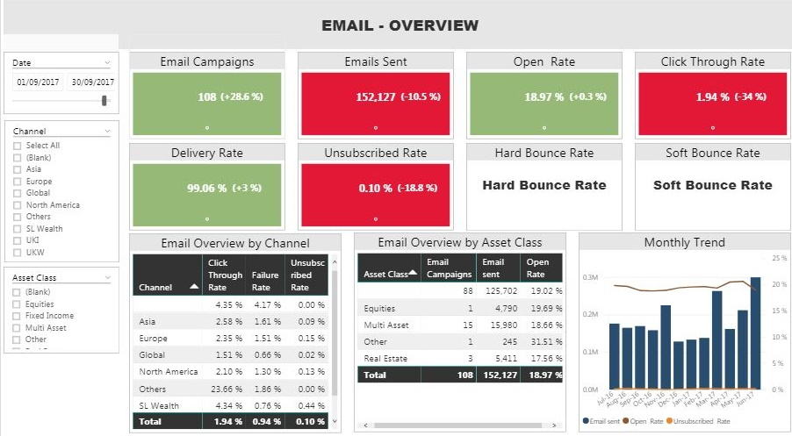
Power BI Screenshots – Sample Deep Dive Views
In the below dashboard screenshot, Email data from Oracle Eloqua & Salesforce CRM is pushed into Power BI and the below dashboards are built with colour coded metrics for business to take decisions on
In the below dashboard screenshot, Webcasts data from BrighTALK & QUMU are pushed into Power BI and the above dashboards are built with colour coded metrics for business to take decisions on

Slide 9
Thank you

Slide 10



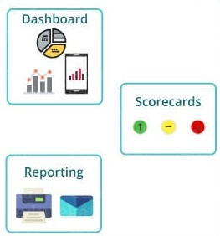












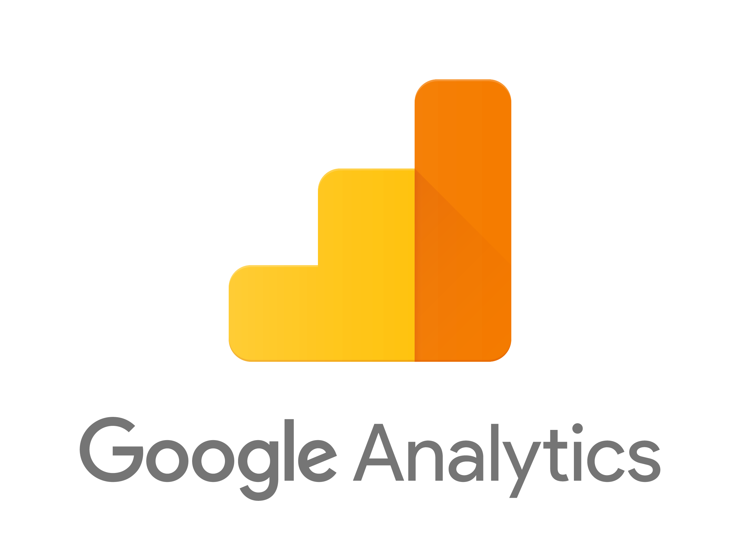






Data ETL Pipeline
Source Systems
Data Warehouse
Reporting/Analytics
On Premises Data
Extract
Personal Desktop
DW Staging Database
Transform & Load
Reporting
Database
Cloud Sources
Extract
Staging ETL Data Acquisition
Fina ETL Data Integration

Slide 11
Case Study – Lead Scoring and Marketing Effectiveness
Objective
Business Benefits
To build Marketing effectiveness dashboard to assess the performance of the campaigns
To build a recommendation engine to identify the best set of targets for every campaign
Improve overall lead conversion through effective targeting
Reduce over/under communication with clients
Recommend appropriate products to clients for cross-sell
Identify the most suitable mode of communication for targeting individual clients
Analyse the pre/post campaign performance to track the success of the campaigns
Single source of truth to track all digital metrics
Methodology

